Slide 1
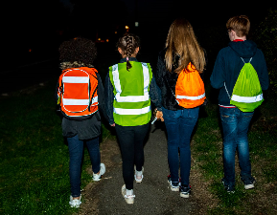
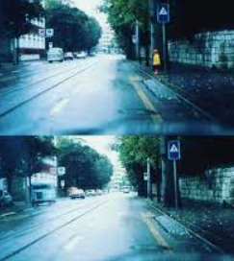
October 2021
Welcome to October’s newsletter. Our Newsletter continues to provide helpful advice, tips and safety messages for you & your family. Parents and Carers are reminded that this newsletter is for both Primary and Secondary school children, and therefore trust your personal judgement to share what you feel is relevant information with your child/s.
Be bright Be seen
Children and young people are often injured in road collisions simply because they
are not easily visible. This becomes more of a problem during the Autumn and
Winter months as heavy rain, fog and shorter daylight hours cause poor visibility.
Be Bright. Be Seen. is an annual Road Safety Campaign which is promoted,
nationally during the month of October, reminding all road users to look out for
each other and to be safe.
The Campaign highlights the importance of being seen on our roads, choosing reflective and fluorescent clothing or accessories when walking or cycling. Children and young people tend to opt for coats and jackets which are darker in colour. Wearing something bright or reflective is important, keeps us safe and is a great help to other drivers and road users. Cyclists should remember it is an offence to cycle in the hours of darkness without a front light, a rear light and a red rear reflector.
It is worth noting that statistics show that child pedestrian road collisions are more likely to occur between the hours of 3:30pm and 4pm. Parents are encouraged to let their children visit the Department for Transport website which combines road safety information with interactive games https://www.think.gov.uk/education-resources/
With just a small Hi Vis accessory your child/s become more visible to other road users. Make it fun too and consider the use of Glow Sticks!
The picture below speaks a thousand words – the same child is in both pictures! Be bright, BE SAFE, be seen.
For more information please visit https://www.think.gov.uk/?s=be+bright+be+seen
Call: 101
Telephone: 18001 101 Visit: cambs.police.uk Follow: CambsCops
Subscribe: eCops.org.uk
#SaferCambs

Slide 2
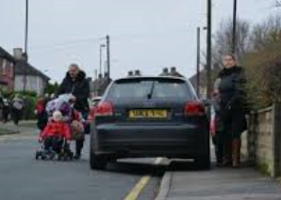
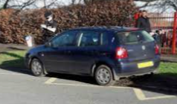
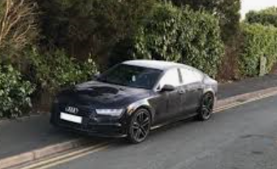
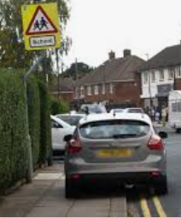
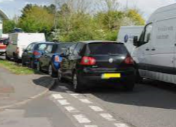
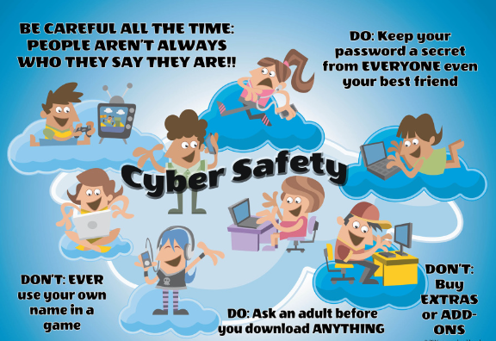
October 2021
Parking outside schools!
We are sure most of you are all aware of the
continuing issues regarding parking outside
schools during drop off and pick up times.
Unsafe, inconsiderate and dangerous parking is an offence and an increasing problem throughout our county, causing chaos for local residents and ultimately putting the safety of our children and others at risk.
Please stop and think before parking. Consider - Am I being respectful? Am I parking illegally? Is my parking dangerous? We can all do our bit to reduce the issues of parking during school pick up & collection times. For the safety of your child, their friends and the local community we kindly request that you all park safety, legally and considerately.
Remember and consider:
DO NOT park on single or double yellow lines
DO NOT double park
DO NOT stop or park on the yellow zig zag lines or pedestrian crossing
DO NOT park on pavements, corners or junctions
DO NOT obstruct footpaths or cycleway’s
Consider car sharing
Walk or cycle to school where appropriate
And finally…DO NOT block the driveways of local residents.
Worried about something that's happened online?
Many children and young people now have a wide range
of information technology at their fingertips such as the
internet, which remains hugely valuable for education,
entertainment and keeping in touch with family and friends.
Most people online will be genuine and supportive, however
some may try to manipulate or force young people into
criminal and sexual activity without them realising.
Therefore, we wish to continue raising awareness of what to
do if something goes wrong online.
For more information, support and advice please click on the
following links from ThinkUKnow.
article for 11 to 13s website
article for parents and carers.
Call: 101
Telephone: 18001 101 Visit: cambs.police.uk Follow: CambsCops
Subscribe: eCops.org.uk
#SaferCambs

Slide 3
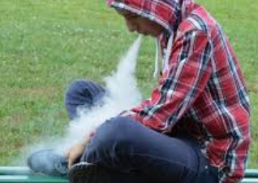
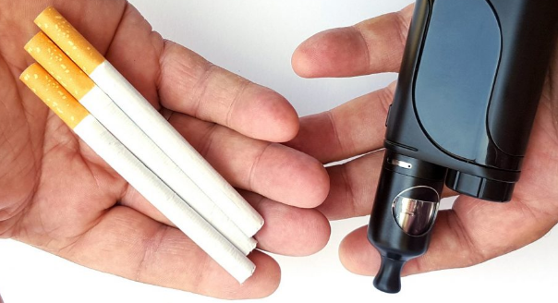
October 2021
Pet Abduction: New law
For many of you who own a dog, we are sure you will agree that your pet is
considered to be a much-loved member of the family. Therefore, if your dog
is lost or stolen it will have a devastating emotional impact on the whole family.
During the COVID pandemic there has been an unprecedented rise in demand for
puppies, but also a worrying increase in the number of dogs reported to have been stolen. This increase in dog theft has led the UK government to review and change the law. The new law will recognise the welfare of the animals and that pets are valued as far more than just property. For more information please follow this government link:
www.gov.uk/government/news/pet-abduction-to-be-made-new-criminal-offence-in-crackdown-on-pet-theft
If you and your family are dog owner’s, we are sure you are taking every manageable step to keep your pet as safe and well as possible, however, here are a few simple tips which may help to protected your four-legged fury friend from being stolen:
Ensure your dog is microchipped
Be careful not to share too much information about your dog on social media
Be mindful of people watching/following you whilst out on a dog walk, keep your dog in sight
Ensure you garden is secure to avoid your dog escaping
Never leave your dog tied up and unattended outside a shop
For further, useful advice and dog theft safety tips, please follow this link for a factsheet created by the Dog’s Trust.
www.dogstrust.org.uk/help-advice/factsheets-downloads/dog%20theft%20fact%20sheet.pdf
The Dangers of Vaping
Could your child be vaping? During the past couple of months there has been an increase
of children and young people being seen across the county vaping while out and about with
friends. It is important to understand the risk to health and the path to addiction if not
openly addressed with our families. Vaping hasn't been around long enough for us to know how it affects the body over time, but Vaping could cause the following health issues.
Slow brain development in children & young people
Affects memory, concentration, learning, self-control, attention, and mood
Increases the risk of other types of addiction as adults e.g. Smoking
Unknown toxins released into the body
There are many different products available however, in brief Vaping can place Nicotine into the body and Nicotine is highly addictive. Some individuals chose to vape Marijuana, THC oil, and other dangerous chemicals. Besides irritating the lungs, these drugs also affect how someone thinks, acts, and feels.
Parents should also be aware that it is illegal to sell e-cigarettes to anyone under the age of 18. If you discover that your child is using them, it may be worth finding out where they’re purchasing or getting them from. If a child is buying the products from a shop, parents may wish to remind the shopkeeper of the law and/or report the retailer to the trading standards department of their local authority. While it may be difficult to stop or prevent your child from smoking, remind them of the health implications and that they’re breaking the law.
For more information on how to educate & support your child if you suspect they are vaping or smoking please visit: https://healthyschoolscp.org.uk/pshe/smoking-and-vaping/
Call: 101
Telephone: 18001 101 Visit: cambs.police.uk Follow: CambsCops
Subscribe: eCops.org.uk
We would love to hear your feedback & comments. You can contact the team via our email Schools&CYP@cambs.pnn.police.uk
#SaferCambs

