Slide 1
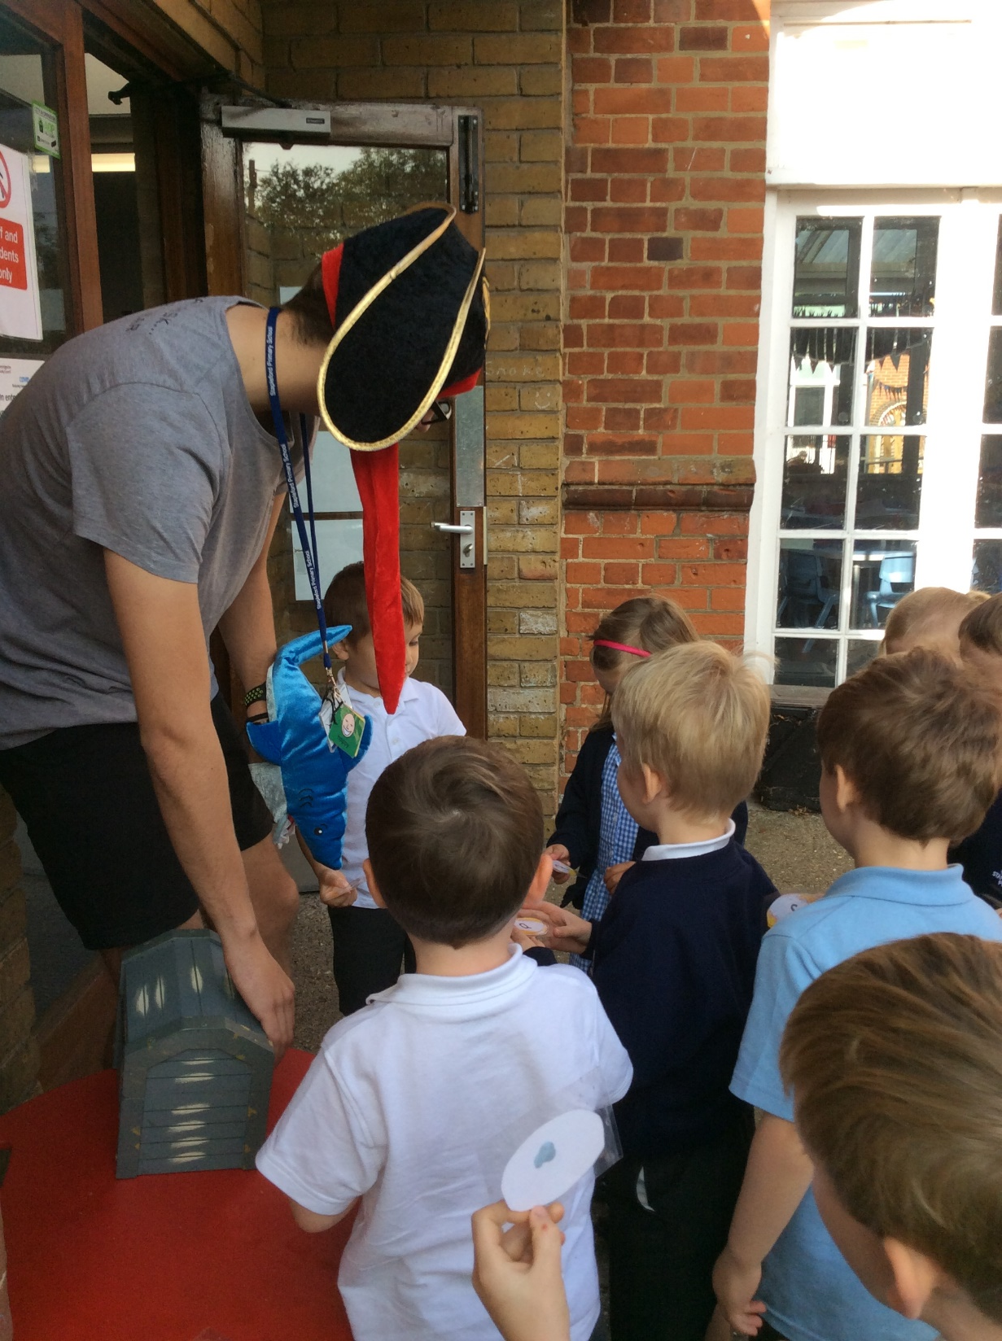
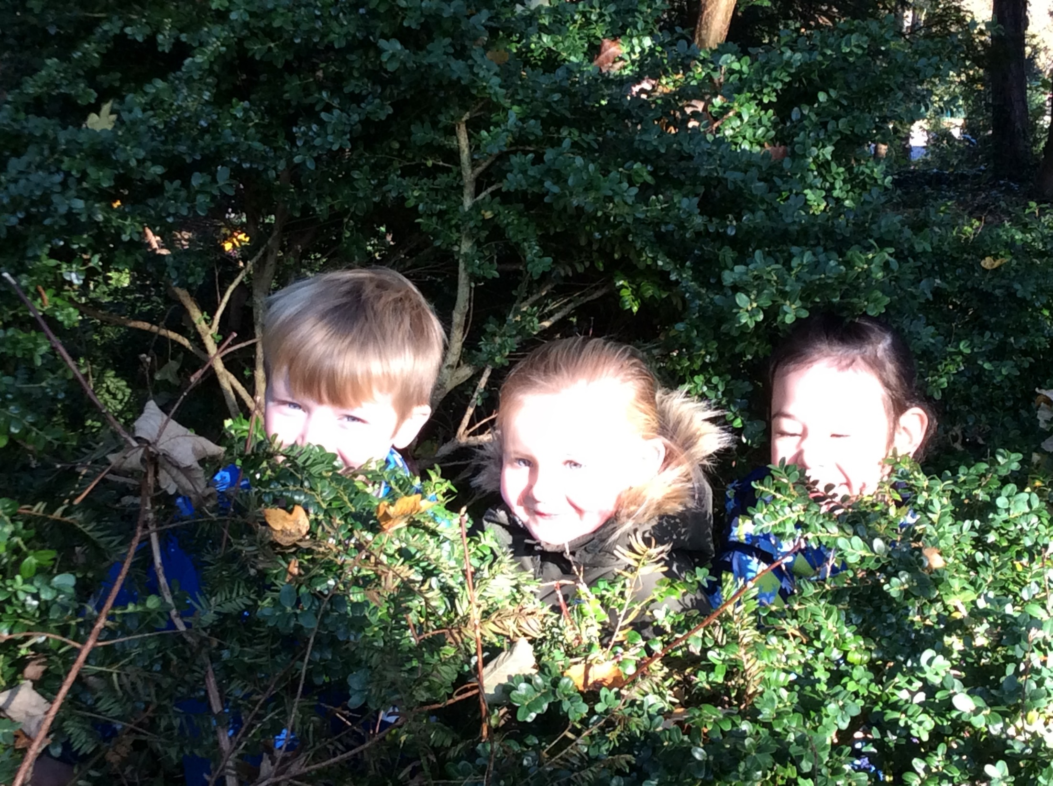
New Parents’ Meeting
Tuesday 12th July 2021
7.00pm

Slide 2
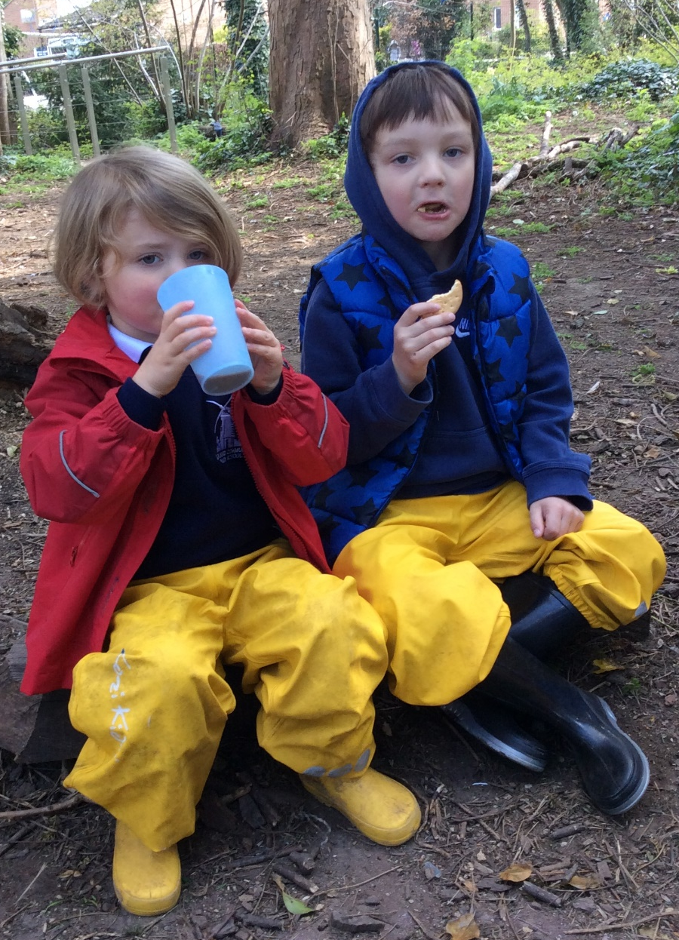
Agenda
Welcome and Introductions – Mrs Christine Spain
Class Teacher – Mrs Jayne Hore
Teaching Assistant – Mrs Mandi Cameron
What to expect as your child
starts school – Mrs Hore

Slide 3
What is the Early Years Foundation Stage (EYFS)?
The EYFS is the stage of education for children from birth to the end of the Reception year.
There is a new EYFS framework that all schools and settings will have to follow from September 2021. These national changes have been made to better support all young children’s learning and development. It is also the aim that the new framework will better prepare children for the transition into key stage 1.
It is based on the recognition that children learn best when playing and exploring, when active learning and when being encouraged to create and think critically.

Slide 4
What do the children learn?
The EYFS Curriculum is separated into 7 areas of learning:
PRIME AREAS: -Personal, Social and Emotional Development
-Communication and Language
-Physical Development
SPECIFIC AREAS: -Literacy
-Mathematics
-Understanding the world
-Expressive arts and design
Notes:
Please see leaflet for further information to read at your leisure. So much to take on board in one evening.

Slide 5
A typical day in Reception
8.50 I will be in the playground. This is a chance to say if there is something I need to know that day e.g. collection arrangements or if something has happened that may affect your child.
9.00 The whistle is blown and the children line up to go in together.
9.00-9.20 Funky fingers – The children come into class, sort out their belongings, register themselves and then get straight on with fine motor play activities.
Notes:
Collection arrangements – If somebody else is collecting your child please let the teachers know – (preferably in writing) and if it’s someone new a photograph of that person really helps! We will not let your child leave with another person without parental permission.
Funky fingers – give examples
For the first two weeks please feel free to come in with your child, help them to self-register and settle them at an activity. However if you feel your child would rather be independent, that is fine too.

Slide 6
A typical day in Reception
9.20 – 9.50 Carpet time – Phonics
9.50 – 10.30 Busy learning time – during this time some children will be working with an adult on an adult-led activity. The other children will be making independent choices from the activities and resources available - child-led activities. During the morning the children have access to milk and a fruit/vegetable snack which we provide.
Notes:
Give examples of WOW cards
Learning through play – last part of the early years foundation stage.
Children’s interests and next steps.

Slide 7
A typical day in Reception
10.30 – 10.45 Playtime
10.45 – 11.00 Quick Maths
11.00 – 12.00 Busy Learning
12.00 - Lunchtime
1.00 Assembly – but only when the children are ready
1.15 – 1.30 Carpet time – Topic Focus
1.30 – 2.55 Busy Learning
2.55 – 3.15 End of day – Story, Show and Tell, discussion about the day’s learning and Star of the Day.
3.15 Parents wait in the front playground and each child is sent out to parents once the teachers have identified that someone is there to collect them.
Notes:
Playtime – children will be in front playground with the Y1 children. Initially CT or TA will be outside with them so that they feel more secure
Quick Maths – Weekly focus – quick carpet input – interactive with the children, e.g. number fans, puppets, singing songs.
Phonics / Guided Reading – additional meeting early in the Autumn term to explain phonics and how we teach reading. Phonics will start straight away – Guided Reading as soon as they’re settled and ready.
Lunch-time, CT will sit with them initially to help them settle. They have the same midday supervisors to provide consistency. They report back to CT any issues – eating, bumps, etc.
Show and Tell – timetable to ensure they all have a go.
Star of the Day – see behaviour leaflet / policy
Seeing children out takes quite a long time initially till we get to know all your faces – please don’t stand too far away and giving us a wave helps.
First few weeks we will spend a lot of time playing with the children, modelling how to use the different areas of the classroom, getting to know them, what their strengths and interests are.
WOW cards – show examples.

Slide 8
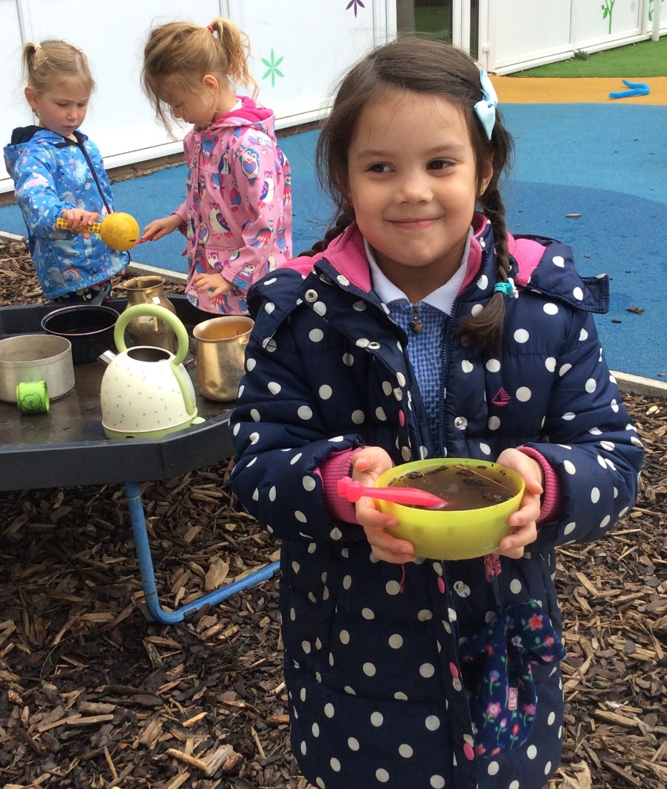
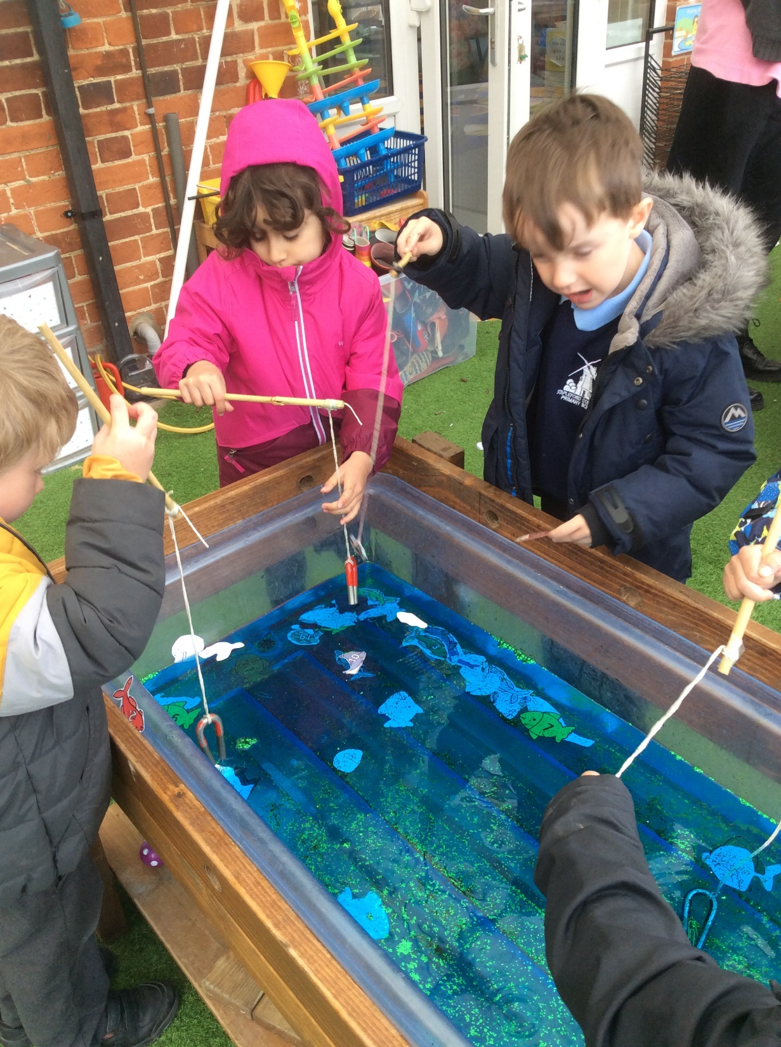
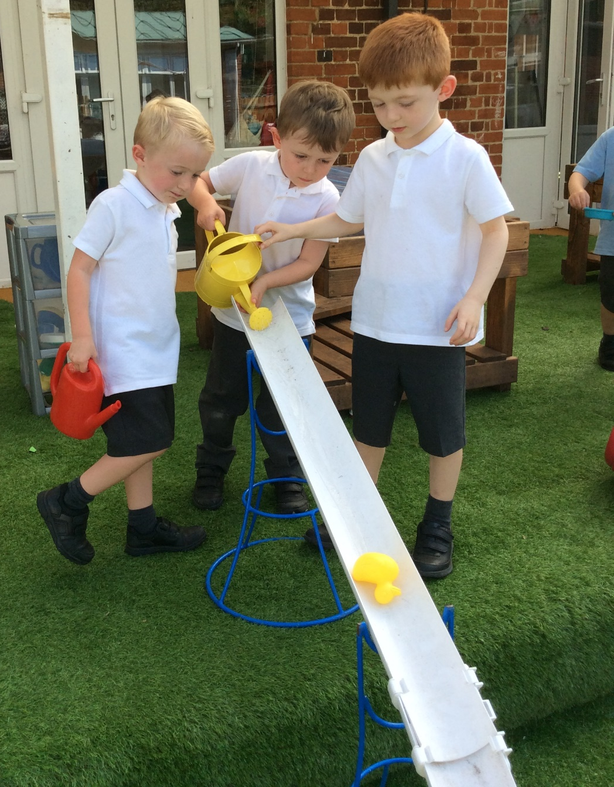
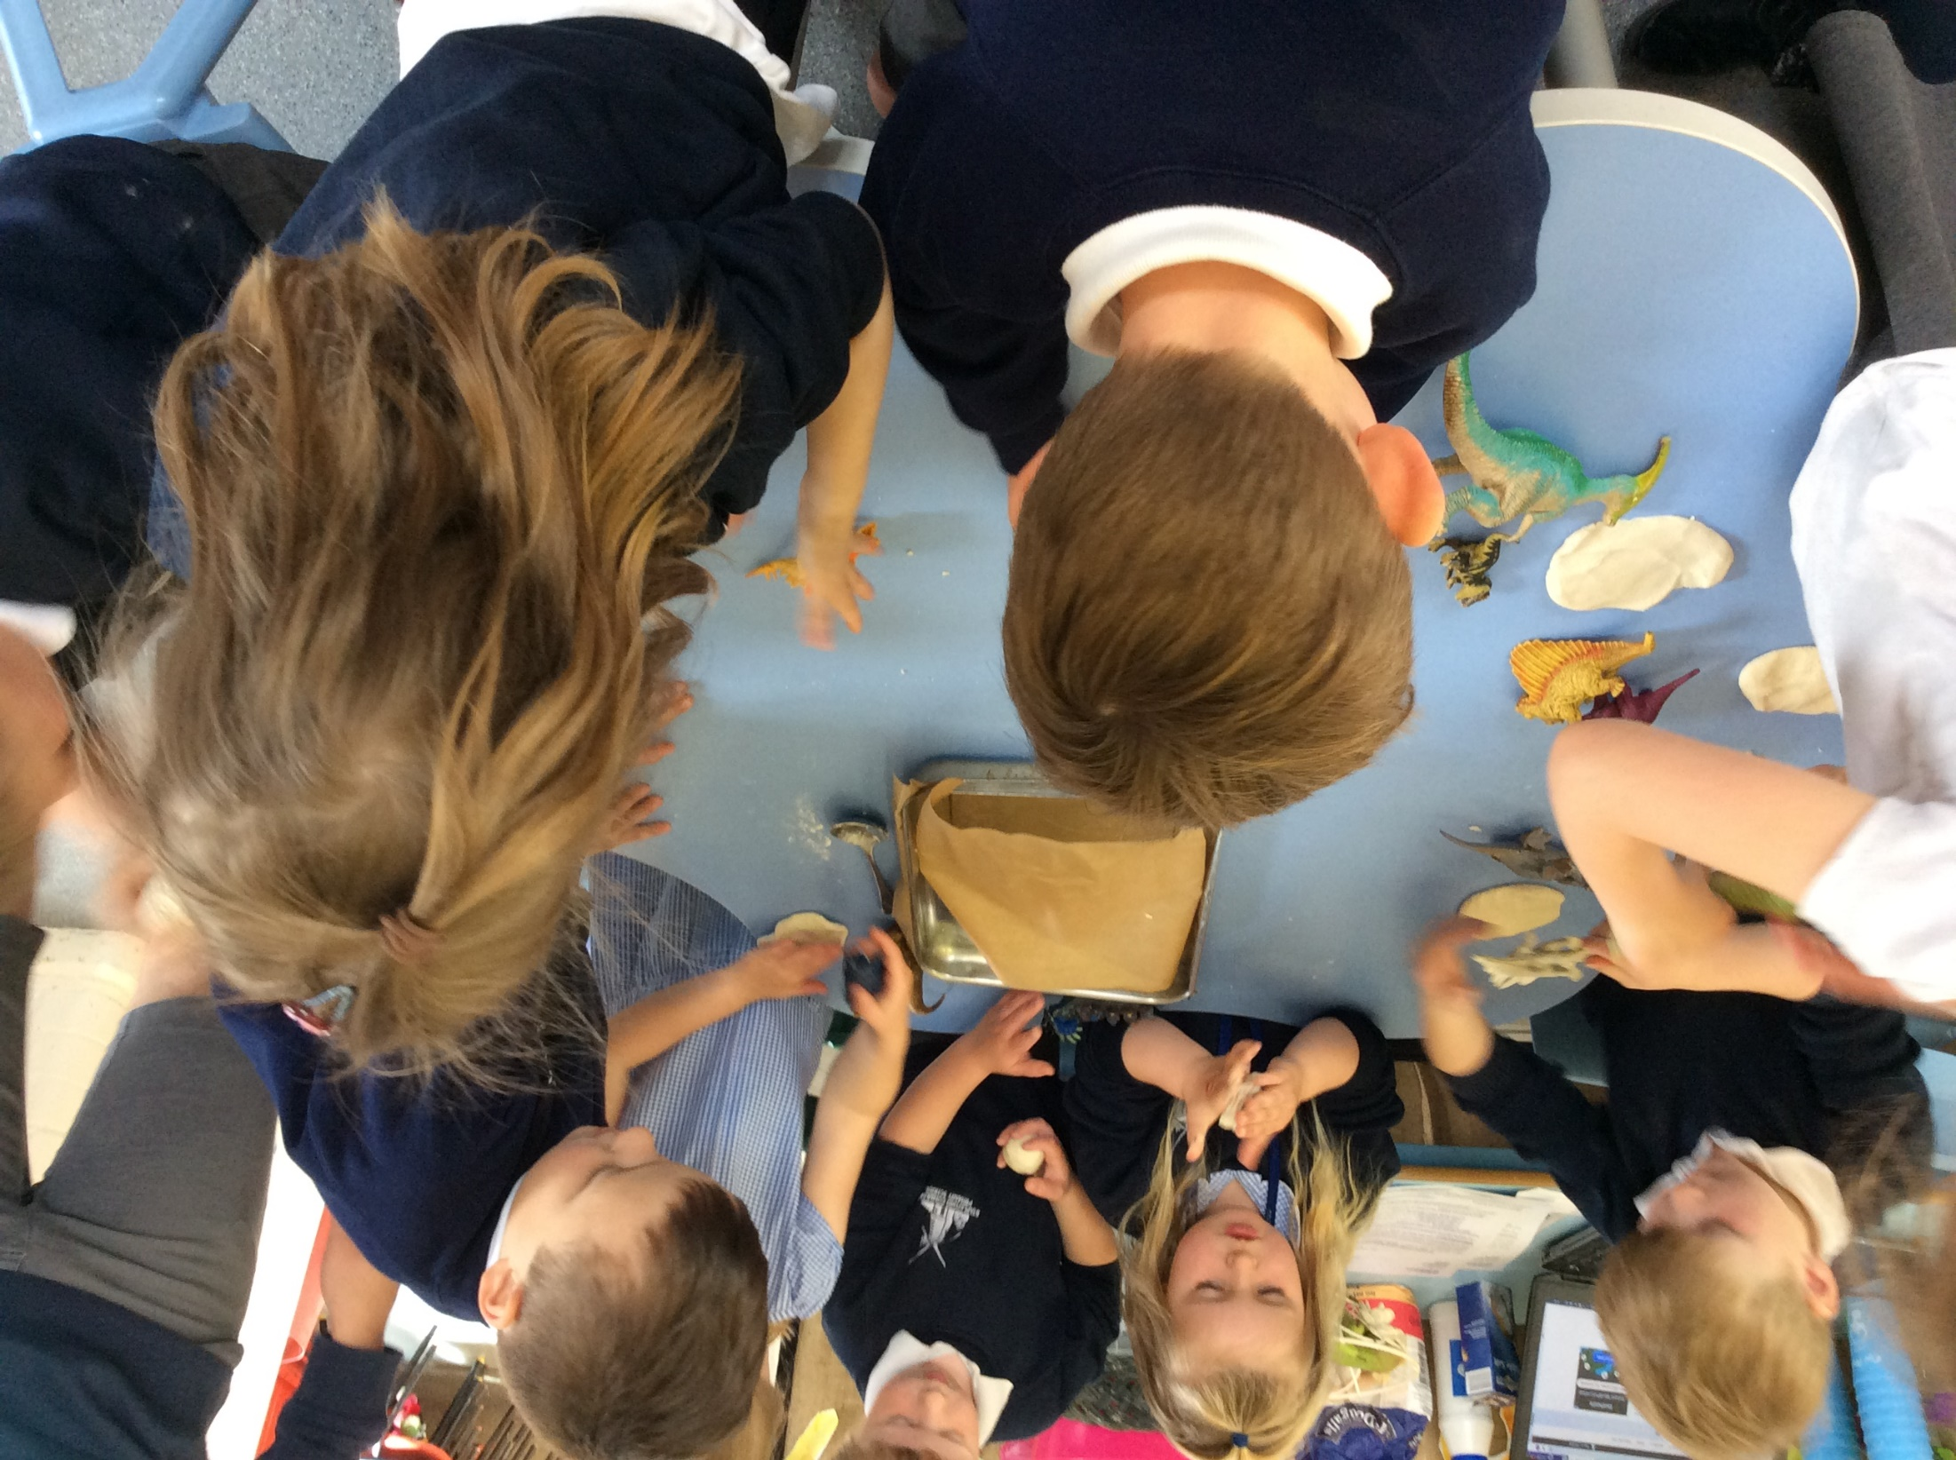
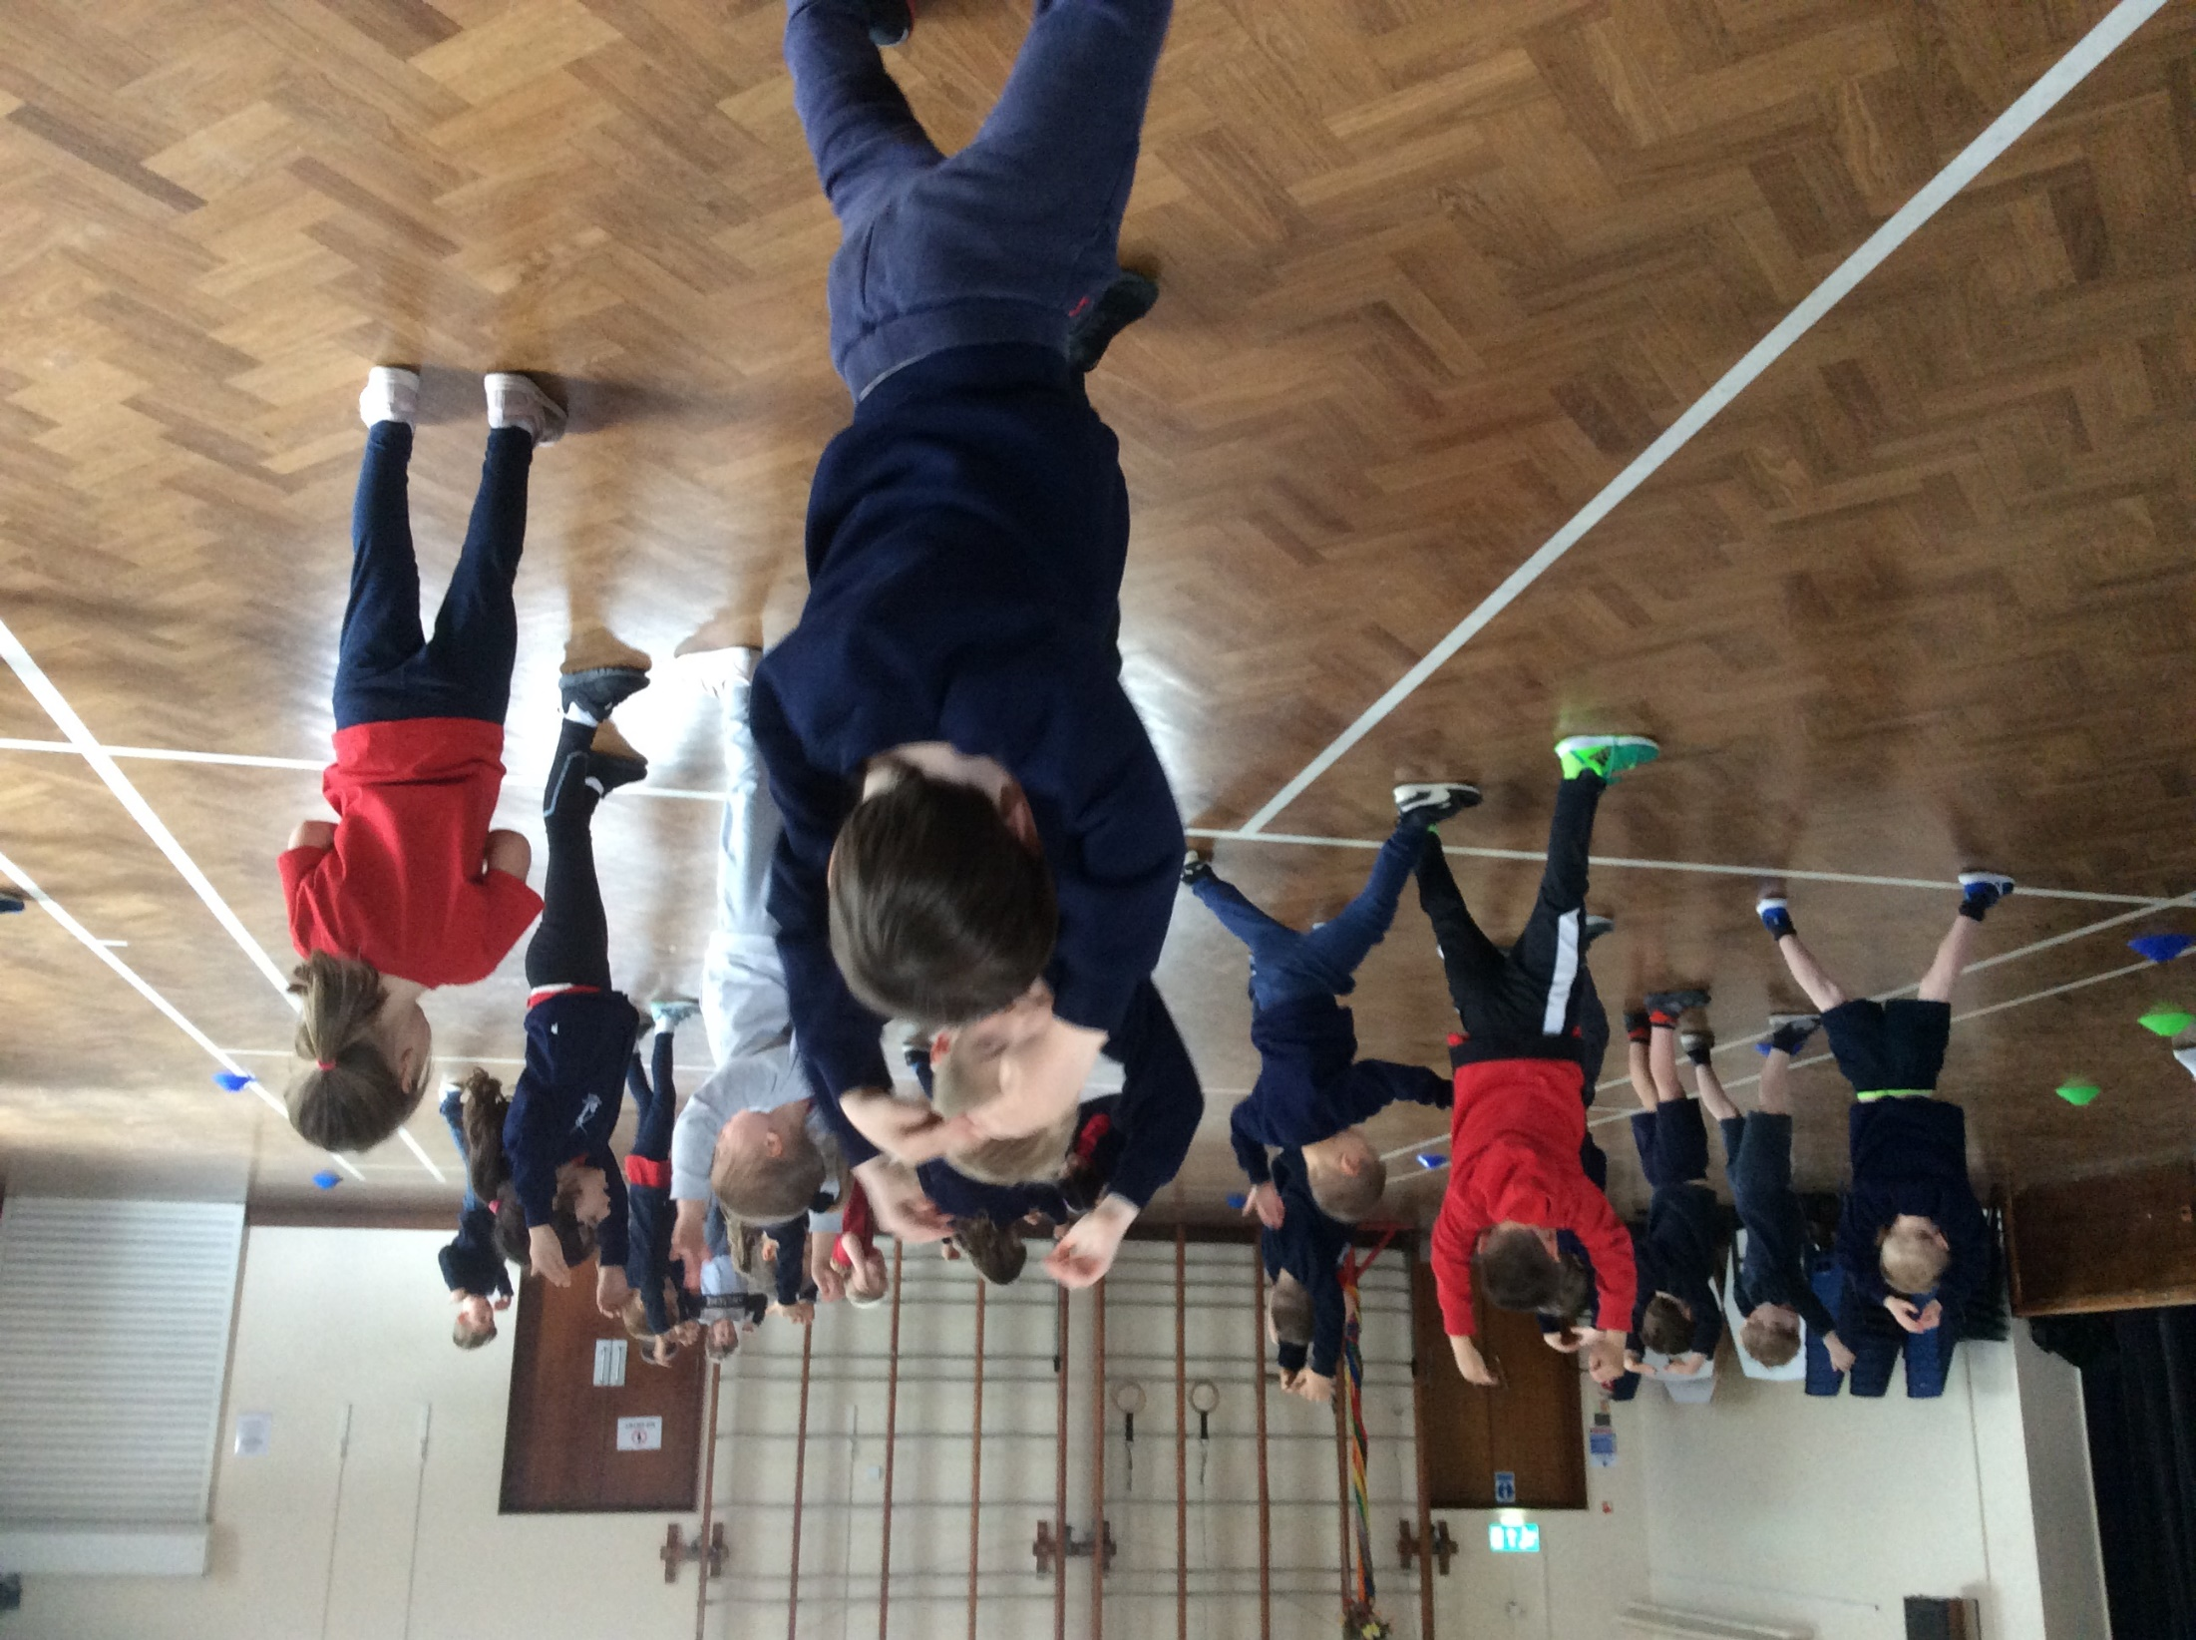

Slide 9
How do we assess the children?
There are two points where we complete formal assessments of the children:
In the first six weeks we complete the short Reception Baseline Assessment which is a new expectation of September 2021.
At the end of the year we complete the Early Years Foundation Stage Profile which provides everyone with information about your child’s attainment against the Early Learning Goals.

Slide 10
Partnership with Parents
You, as parents and carers are your child’s first and most important educators. Evidence shows that when parents and school work closely together, the greatest impact on children’s development and learning is seen. Here are some of the ways we try to work really closely with you:
Regular Communication – parents’ evenings each term and informal communication. The end of the day is best to catch me or you can make an appointment via the office.
Weekly update of children’s learning which will include suggested home learning activities. This will be sent home on a Friday and is also on the class page of the website
Letters are sent home either via Parent Mail or in the children’s book bags.
Curriculum Letters and Topic Webs are sent out each half term.
WOW cards and Tapestry - online learning journals.

Slide 11
What can you do to help?
Talk, read and count!
Promote your child’s independence in getting dressed, washing their hands, doing up their coats and toileting.
Play games together, practising sharing and taking turns.
Talk positively about starting school – there are lots of lovely books that you could read together.

Slide 12
Practical Matters!
All clothing and items named please!
Drinks - Please can the children bring in a named water bottle each day. In Reception, they also are provided with a glass of milk.
Snacks – In Reception and Key Stage 1 children are provided with a fruit/vegetable snack each day.
Book bags – please can your child bring their named, book bag into school each day.
Wellies – please could you send your child with a named pair of welly boots that stay in school as we endeavour to get outside in all weathers and we visit the moat each week.

Slide 13
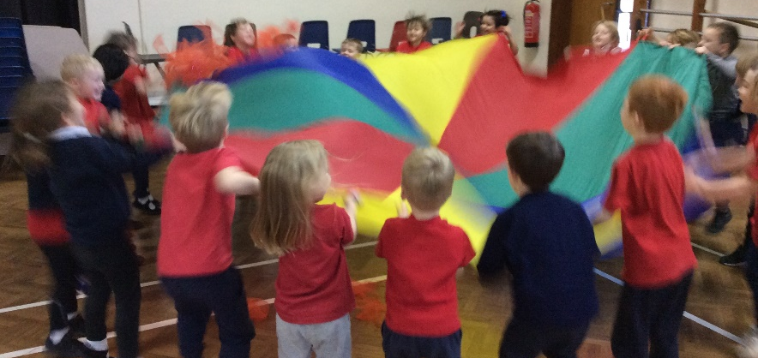
Practical Matters!
Lunch – Reception and Key Stage 1 children can have a free school dinner. Please send them in with a named packed lunch if they are not having a school lunch.
Collection Arrangements - Please let us know if someone different is collecting your child.
Illness – if your child is unwell, please call the office and let them know. Your child needs to be kept off school for 48 hours after a last bout of sickness or diarrhoea.

Slide 14
Starting Arrangements
Thursday 2nd September – home visits - parents to book in.
Friday 3rd September – home visits – parents to book in.
Monday 6th September – children all in am – collect at 12pm
Tuesday 7th September – children all in am – collect at 12pm
Wednesday 8th September – children all in am and lunch – collect at 1pm
Thursday 9th September – children all in full-time.
All the above arrangements are flexible through discussion between staff and parents
Notes:
Please sign up for home visit.
Please trust us when we say that it is time to leave.

Slide 15
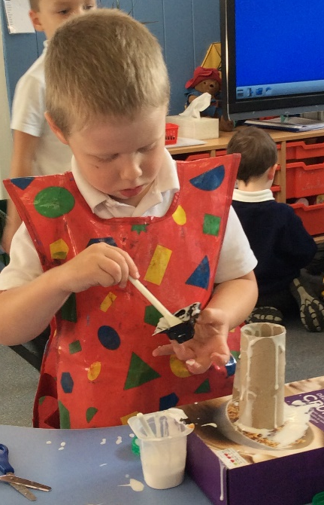
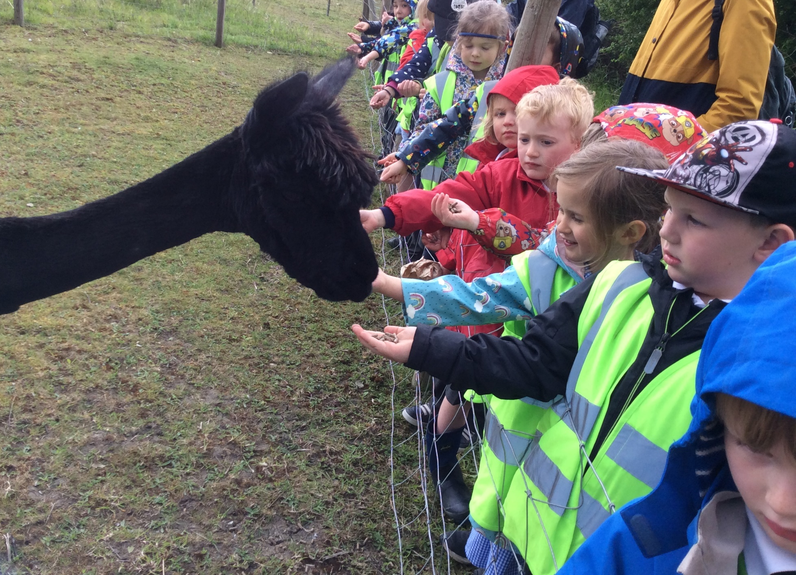
And finally…
Teddy Bear’s Picnic tomorrow 1.30-2.45
We will be asking you to sign up for a home visit.
We can’t wait to welcome you and your child into our school!
Any Questions?

